Slide 1
Android vs. iOS: The Battle for Mobile Operating System Dominance

Slide 2
Abstract
Intense competition between Android and iOS for dominance in the mobile operating system market.
Android, launched by Google, aimed at controlling the emerging mobile internet landscape.
iOS, Apple's proprietary system, initially dominated but faced a growing threat from Android.
Android gained rapid acceptance among consumers and handset makers, challenging iOS.
Android's open-source nature provided to mobile operators for free contrasted with iOS's exclusivity to Apple devices.
iOS boasted the largest number of applications initially, but Android's developer-friendly environment led to a surge in its app availability.
Competition extended to other devices like tablets, highlighting the significance of the mobile operating system in portable computing.
Google planned to introduce low-cost Android smartphones in emerging markets like India and China, intensifying the competition.

Slide 3
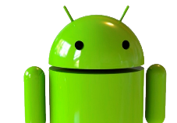
History : Android
Founding of Android Inc:
Established in October 2003 in Palo Alto, California by Rich Miner, Nick Sears, Chris White, and Andy Rubin.
Initially aimed at developing smarter mobile devices with a focus on location and user preferences.
Shift Towards Mobile Phones:
Originally intended for digital cameras, Android Inc pivoted towards mobile phones due to the declining camera market.
Acquisition by Google:
Google acquired Android Inc in 2005, leading to a significant shift in direction.
Decision to use Linux as the basis for the Android OS allowed offering it to third-party manufacturers for free.
Creation of Android Logo:
Irina Blok designed the iconic Android logo, resembling a robot and a green bug, while working for Google.
Inspired by restroom logos and aimed to represent a robot, the logo was made open-source under Creative Commons 3.0 Attribution License.

Slide 4
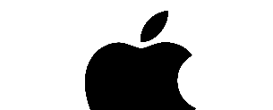
History : IOS
Founding of Android Inc:
Established in October 2003 in Palo Alto, California by Rich Miner, Nick Sears, Chris White, and Andy Rubin.
Initially aimed at developing smarter mobile devices with a focus on location and user preferences.
Shift Towards Mobile Phones:
Originally intended for digital cameras, Android Inc pivoted towards mobile phones due to the declining camera market.
Acquisition by Google:
Google acquired Android Inc in 2005, leading to a significant shift in direction.
Decision to use Linux as the basis for the Android OS allowed offering it to third-party manufacturers for free.
Creation of Android Logo:
Irina Blok designed the iconic Android logo, resembling a robot and a green bug, while working for Google.
Inspired by restroom logos and aimed to represent a robot, the logo was made open-source under Creative Commons 3.0 Attribution License.

Slide 5
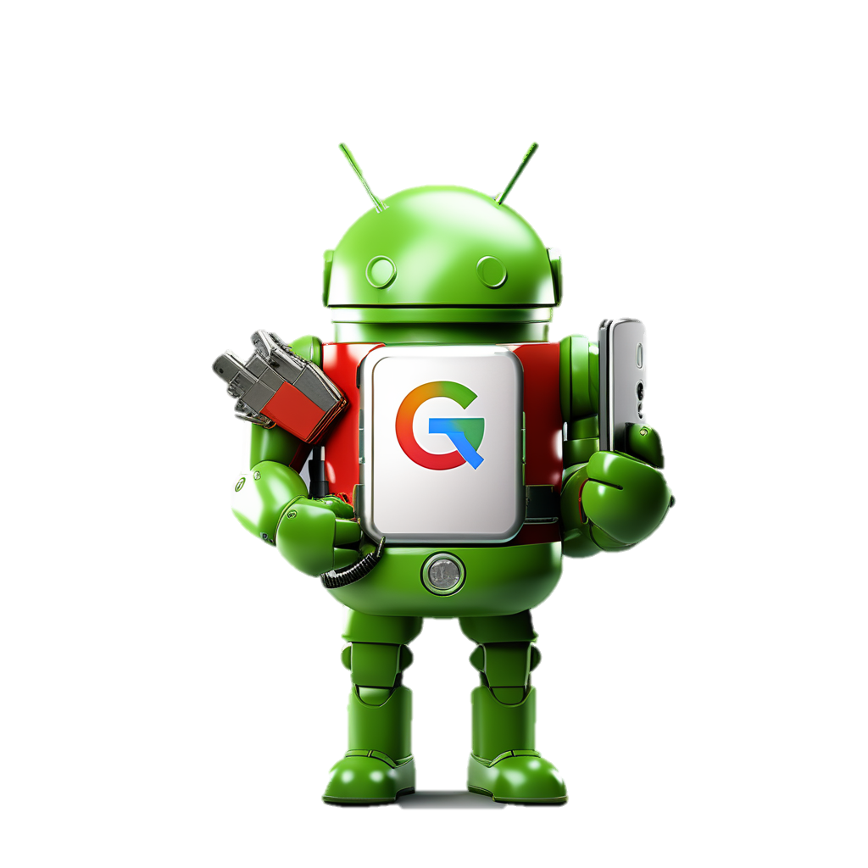
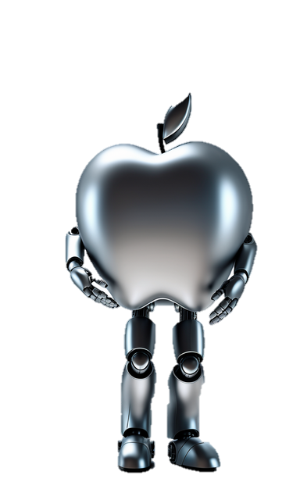
Introduction
The rise of Android in the smartphone market defied initial skepticism, as Google entered the mobile operating system arena. Despite doubts about its viability against industry giants like Apple and RIM, Android rapidly gained traction, offering a compelling alternative to iOS. Analysts initially viewed Android as a potential financial burden for Google, but its success silenced critics. Gartner's prediction of Android surpassing iOS fueled expectations, intensifying the battle for dominance in the mobile sector. Android's open-source nature, preferred by third-party developers, and partnerships with major handset manufacturers and telecom operators fueled its rapid growth. This led to Android becoming the operating system of choice for many top smartphones, challenging Apple's dominance and reshaping the mobile landscape.

Slide 6
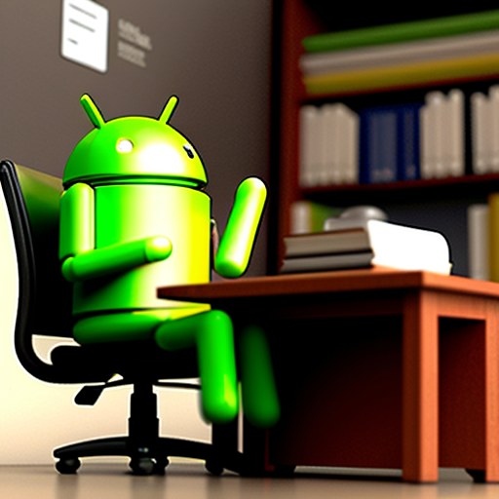
Why we use android?
Android is widely adopted for several key reasons. Firstly, its open-source nature provides flexibility and customization options for both developers and users, fostering innovation and diversity in the ecosystem. Secondly, Android offers compatibility with a wide range of devices, enabling its widespread adoption across various manufacturers and price points. Additionally, Android boasts a vast array of apps and services available through the Google Play Store, enhancing user experience and functionality. Furthermore, the seamless integration with Google's ecosystem, including services like Gmail, Google Maps, and Google Assistant, provides added value to users. Overall, Android's versatility, affordability, app ecosystem, and integration with Google services make it a popular choice for smartphone users worldwide.

Slide 7
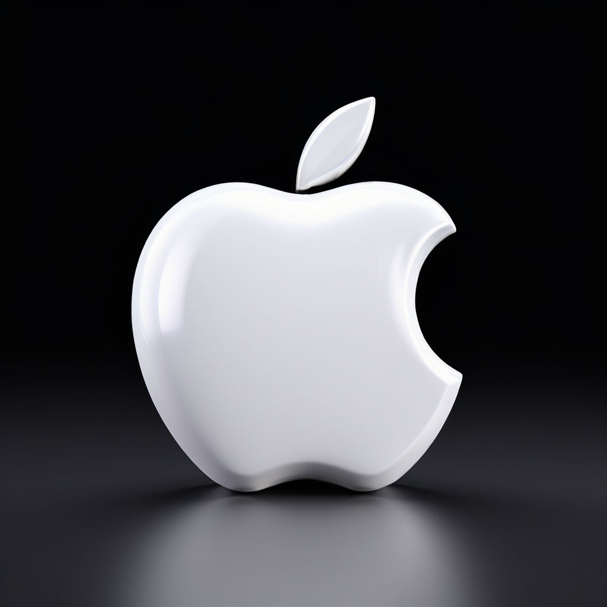
Why we use IOS?
iOS, Apple's operating system for mobile devices, is widely used for several reasons. Firstly, iOS is known for its seamless integration across Apple devices, providing a unified ecosystem for users. This integration allows for easy sharing of data and continuity of tasks between devices, enhancing user experience. Secondly, iOS offers high levels of security and privacy features, making it a preferred choice for users concerned about data protection. Additionally, iOS is known for its user-friendly interface and intuitive design, making it accessible to a wide range of users, including those less familiar with technology. The App Store, curated by Apple, offers a vast selection of high-quality applications, further enhancing the iOS experience. Overall, iOS is valued for its integration, security, user-friendliness, and app ecosystem, making it a popular choice for mobile users worldwide.

Slide 8
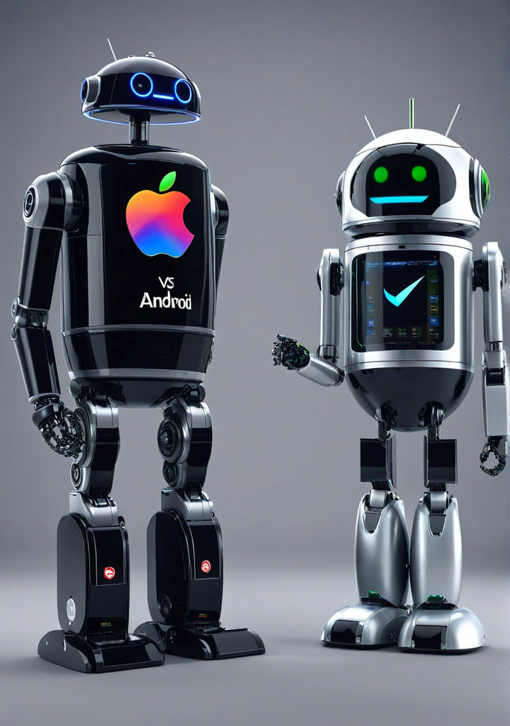
iOS vs. Android: “A Comprehensive Comparison”
This presentation provides an in-depth analysis of the key differences between iOS and Android operating systems, focusing on various aspects such as user interface, exclusive features, software upgrades, speed, available apps, stability, device selection, security, privacy, customization, hardware options, and voice commands.

Slide 9
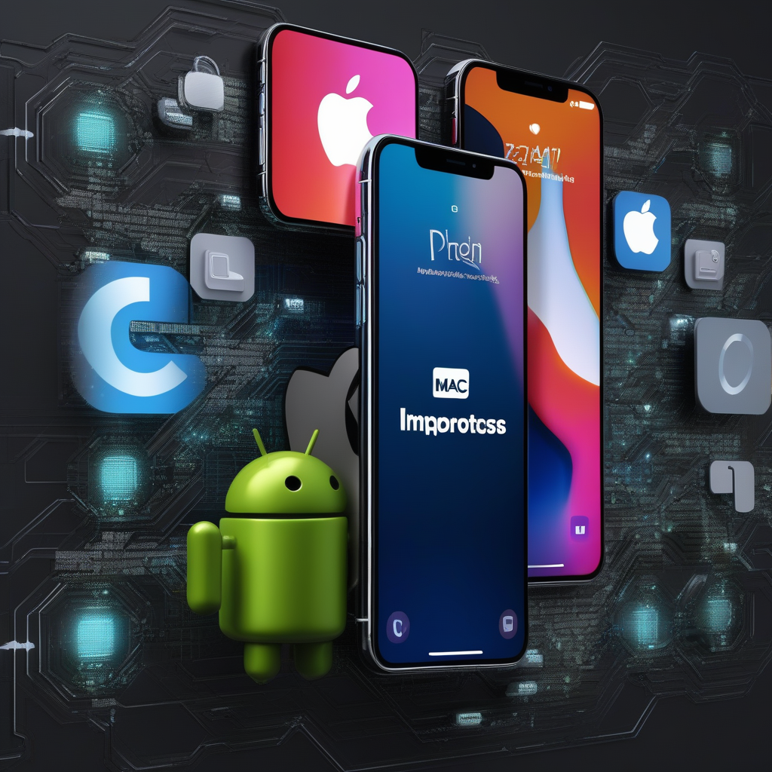
Key points
User Interface (UI) and Design
Exclusive Features
Software Upgrades
Speed
Apps Available
Security and Privacy

Slide 10
Applications
Communication and Social Networking
Entertainment
Productivity and Utility
Navigation and Travel
Applications
Multimedia and Creativity
Health and Fitness
E-commerce and Finance
Education and Learning
Android
IOS

Slide 11
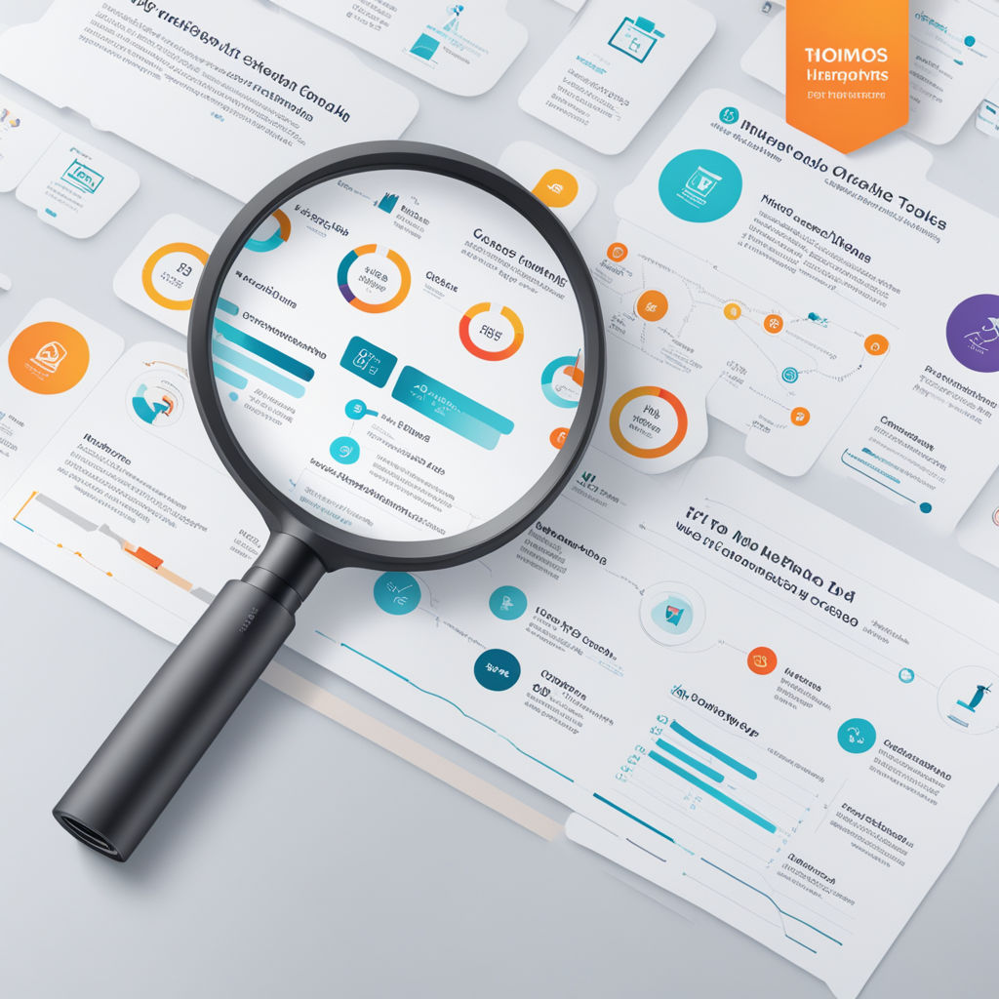

Diagrams and Charts

Slide 12
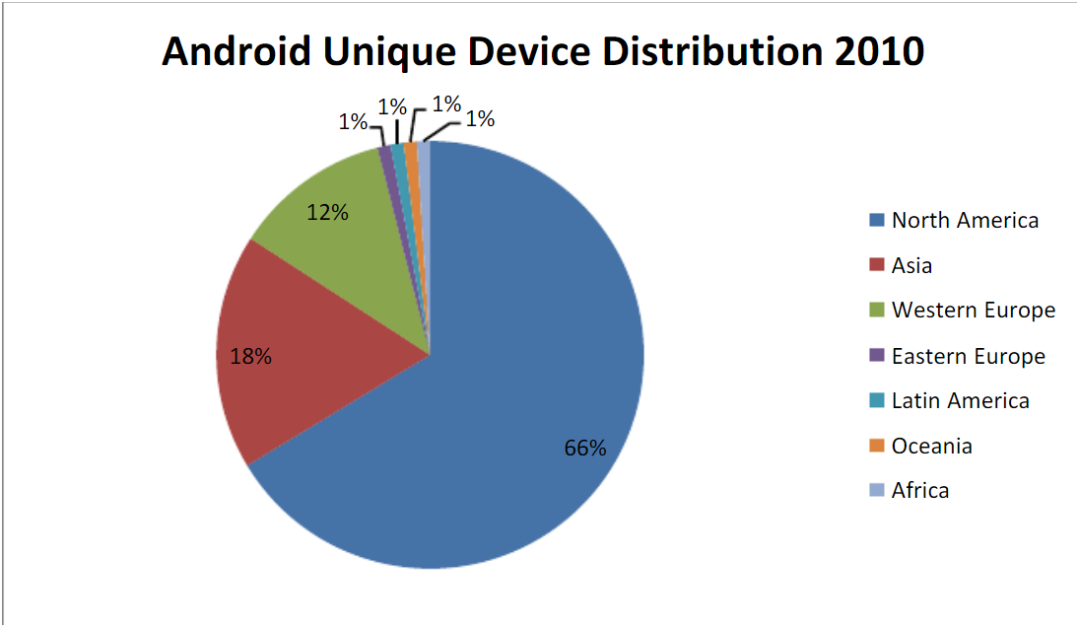

Slide 13
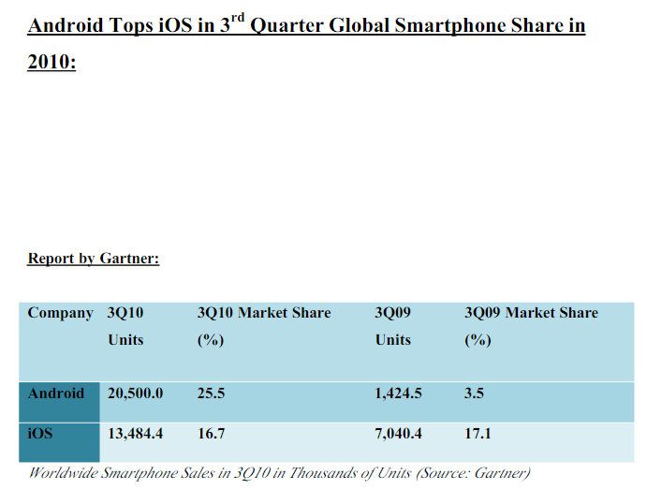

Slide 14
Advantages
Open Source: Android is an open-source platform, allowing for greater customization and flexibility for developers.
Hardware Diversity: Android runs on a wide range of devices manufactured by various companies, offering users more choices in terms of features, design, and price.
Customization: Android allows users to customize their device's interface, install third-party apps from sources other than the official app store, and tweak system settings to their preferences.
Google Services Integration: Tight integration with Google services such as Gmail, Google Maps, and Google Drive provides seamless access to these services.
Affordability: Android devices are available at various price points, making them more accessible to a wider range of users.

Slide 15
Disadvantages
Fragmentation: The Android ecosystem is fragmented, with multiple versions of the operating system and varying levels of hardware capabilities across devices. This can lead to compatibility issues and slower software updates.
Security Concerns: Due to its open nature, Android is more susceptible to malware and security threats compared to iOS. Users need to be vigilant about security measures and app permissions.
Inconsistent User Experience: Different manufacturers may apply their own customizations and skins on top of Android, leading to inconsistencies in user experience across devices.
Slower Updates: Android updates may take longer to roll out to devices due to the involvement of manufacturers and carriers in the update process. This can result in delayed access to new features and security patches.

Slide 16
Advantages
Uniform User Experience: iOS offers a consistent and intuitive user experience across all Apple devices, ensuring familiarity and ease of use for users.
Optimized Hardware-Software Integration: Apple designs both the hardware and software for its devices, leading to optimized performance, efficiency, and seamless integration between the two.
App Quality: The App Store has strict guidelines for app submission, resulting in a curated selection of high-quality apps that are generally well-optimized for iOS devices.
Security: iOS is known for its strong security features, including built-in encryption, sandboxing of apps, and strict app permissions. This makes iOS devices less vulnerable to malware and security breaches.
Timely Updates: Apple releases iOS updates directly to its devices, ensuring timely access to new features, performance improvements, and security patches for all supported devices.

Slide 17
Disadvantages
Limited Customization: iOS offers limited customization options compared to Android, with users having less control over the device's interface and system settings.
Closed Ecosystem: iOS devices are tightly integrated into Apple's ecosystem, limiting interoperability with non-Apple devices and services.
Hardware Options: Apple offers a limited range of device models and configurations compared to the variety available in the Android market, potentially limiting options for users with specific preferences or budget constraints.
Higher Cost: iOS devices tend to be more expensive than their Android counterparts, making them less accessible to budget-conscious consumers.

Slide 18
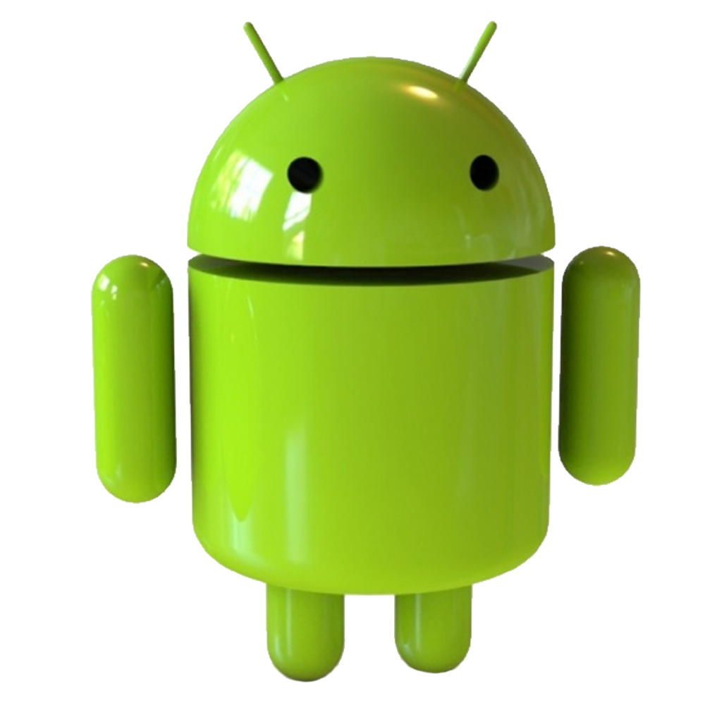
Future Enhancement
Improved Privacy Features
Foldable Device Optimization:
Improved Cross-Device Integration
Enhanced AI Integration
Augmented Reality (AR) Integration

Slide 19
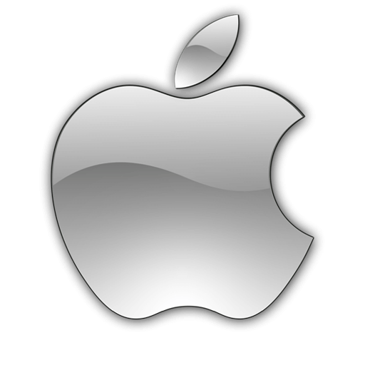
Future Enhancement
Privacy Enhancements
Foldable Device Optimization:
Improved Cross-Device Integration
Enhanced AI Integration
Augmented Reality (AR) Integration

Slide 20
Customizability: Android offers way more customization options, from launchers to widgets. If you like to tinker with your phone, Android is for you.
Ease of Use: iPhones are known for their user-friendly interface. If you just want a phone that works seamlessly, iOS is a good choice.
Price: Android devices come in a wider range of prices, from budget-friendly to high-end. iPhones tend to be on the pricier side.
App Selection: Both platforms have a vast app selection, but some high-profile apps might launch first on iOS.
Security: Both iOS and Android are secure, but Android updates can be slower depending on the device and manufacturer.

